Slide 1
Detection of meteors in broad daylight: a feasibility study
Jérémie Vaubaillon (IMCCE)
Sylvain Rommeluere, Pierre Simoneau (ONERA)

Slide 2
Introduction / questions
Rossano et al., 2001 (from a few frames) concluded meteors emit 25 times more energy in M-IR band [3;5] μm than in visible band
=> Q1: how do meteors emit light in M-IR band?
Sky brightness decreases with altitude
=> Q2: How dark is the sky in M-IR band as a function of altitude?
Q3: Can we detect meteors in broad daylight? IOW: what is the S/N for meteors in M-IR?

Slide 3
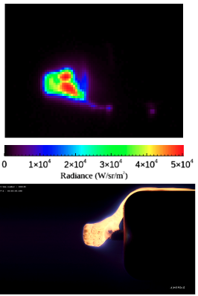
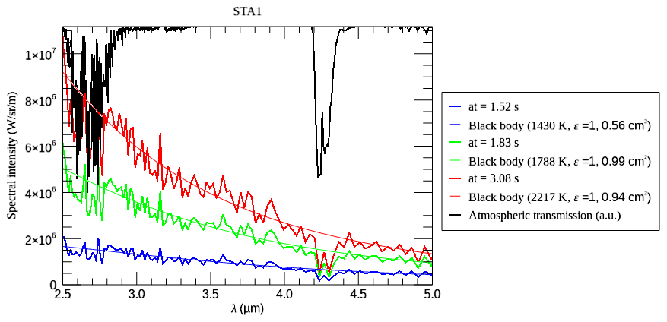
Q1: how do meteors emit light in M-IR band?
Rommeluere et al. 2024: Black body at ~2000 K emission
Very ≠ from Rossano et al., 2001…
M-IR
Stannern
Visible
Bilanga
Notes:
Black body emission
Sample behaviour similar in M-IR and Visible
Light curve in M-IR somewhat similar to Visible, but sometimes show slower rise
Max sample Temperature [1800 - 2500] K ; from Vis to N-IR spectra and from M-IR (alone) measurements

Slide 4
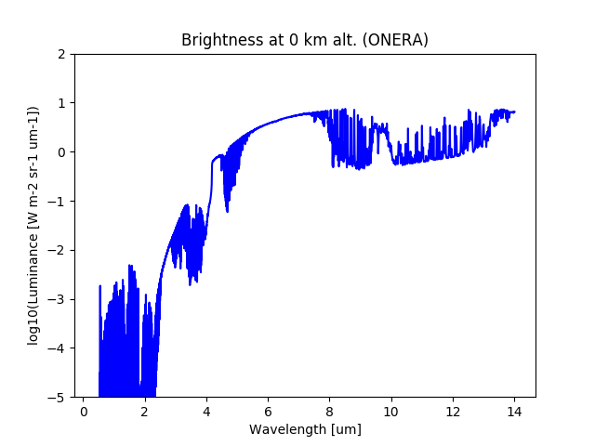
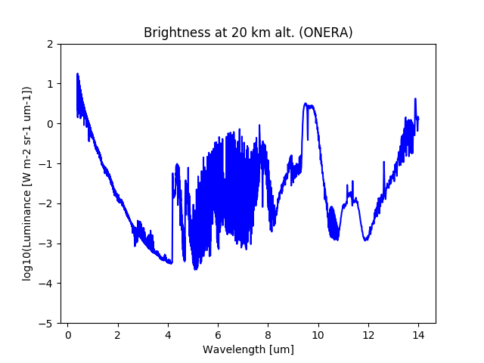
Q2: How dark is the sky in M-IR band?
Sky brightness
At night, from ground
Sky brightness
At noon, from 20 km of altitude
Calculations performed with Rayjn software (Simoneau et al., 2017)

Slide 5
Computation of S/N at the pixel Voltage level (1/2)
Input
M-IR instrument: F=100 mm f/2, QE=0.8, exptime=5 ms (20 fps), Tsensor = 80 K ; readout + dark noises
Target : 1 cm³ ; Black body emission at 2000 K (conclusion from wind tunnel experiment) ; distance=f(geometry) ; Alt=100 km ; NOT resolved by camera+lens
Sky brightness and transmission computations: Alt=[15,20,30,40] km ; Az=[0,90,180] deg, El=[10,30,45,70,80] deg ; dates=winter, summer

Slide 6
Computation of S/N at the pixel Voltage level (2/2)
Compute:
Sky transmission and luminance (=background) as well as meteoroid luminance [ph.m^{-2.}s⁻¹] => Convert to photo-electrons
Instrument signal (readout, dark, sky, meteor) at pixel level
Tension V at pixel created by each contributor (noise, sky, meteor)
S/N = Vmeteor / (Vsky + Vnoise)

Slide 7
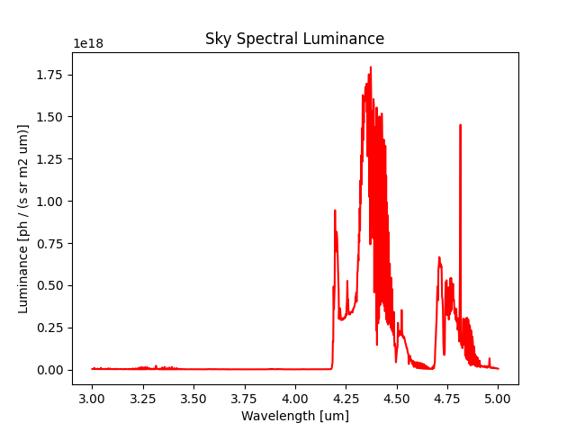
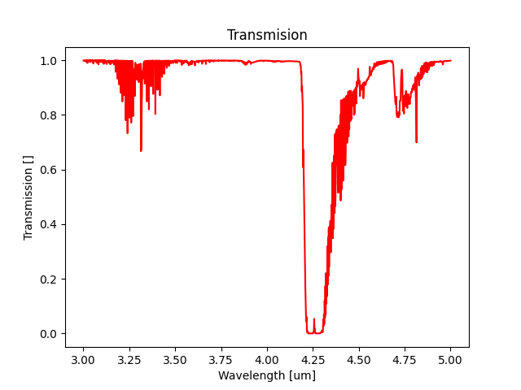
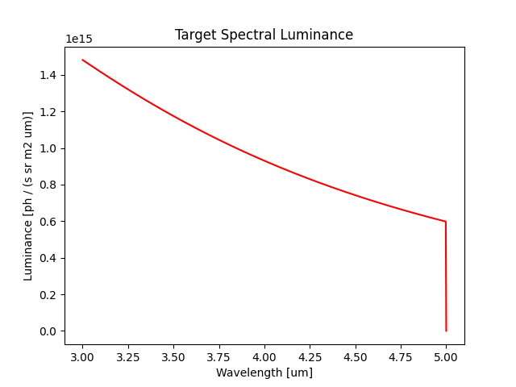
Luminances and transmission
Winter ; Alt=20 km, Az=90 deg, El=45 deg
Sky
Meteor

Slide 8
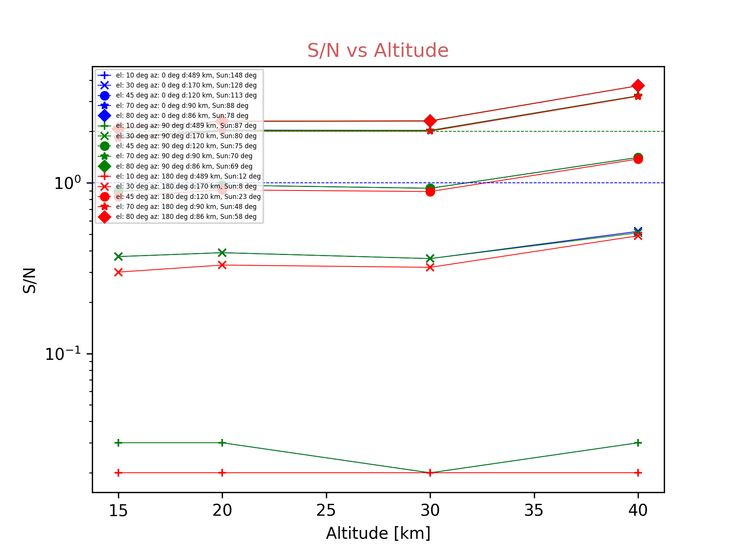
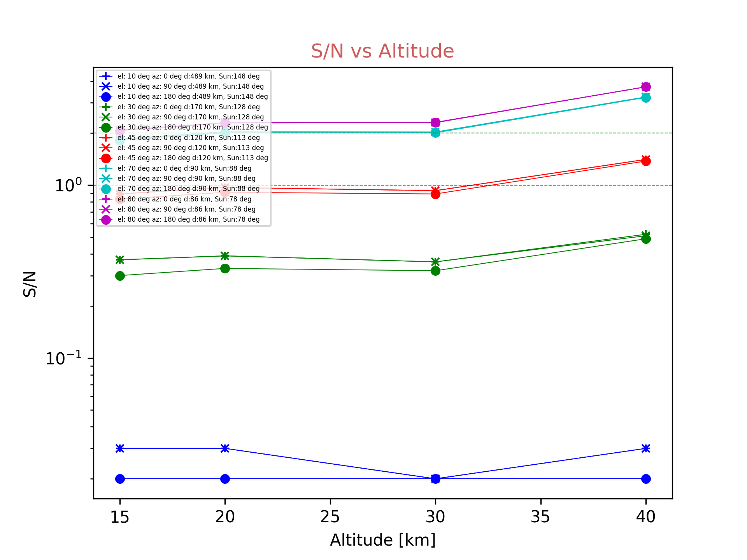
S/N over the whole M-IR band
Az=0 deg
Az=90 deg
Az=180 deg
El=80 deg
El=45 deg
El=30 deg
El=10 deg

Slide 9
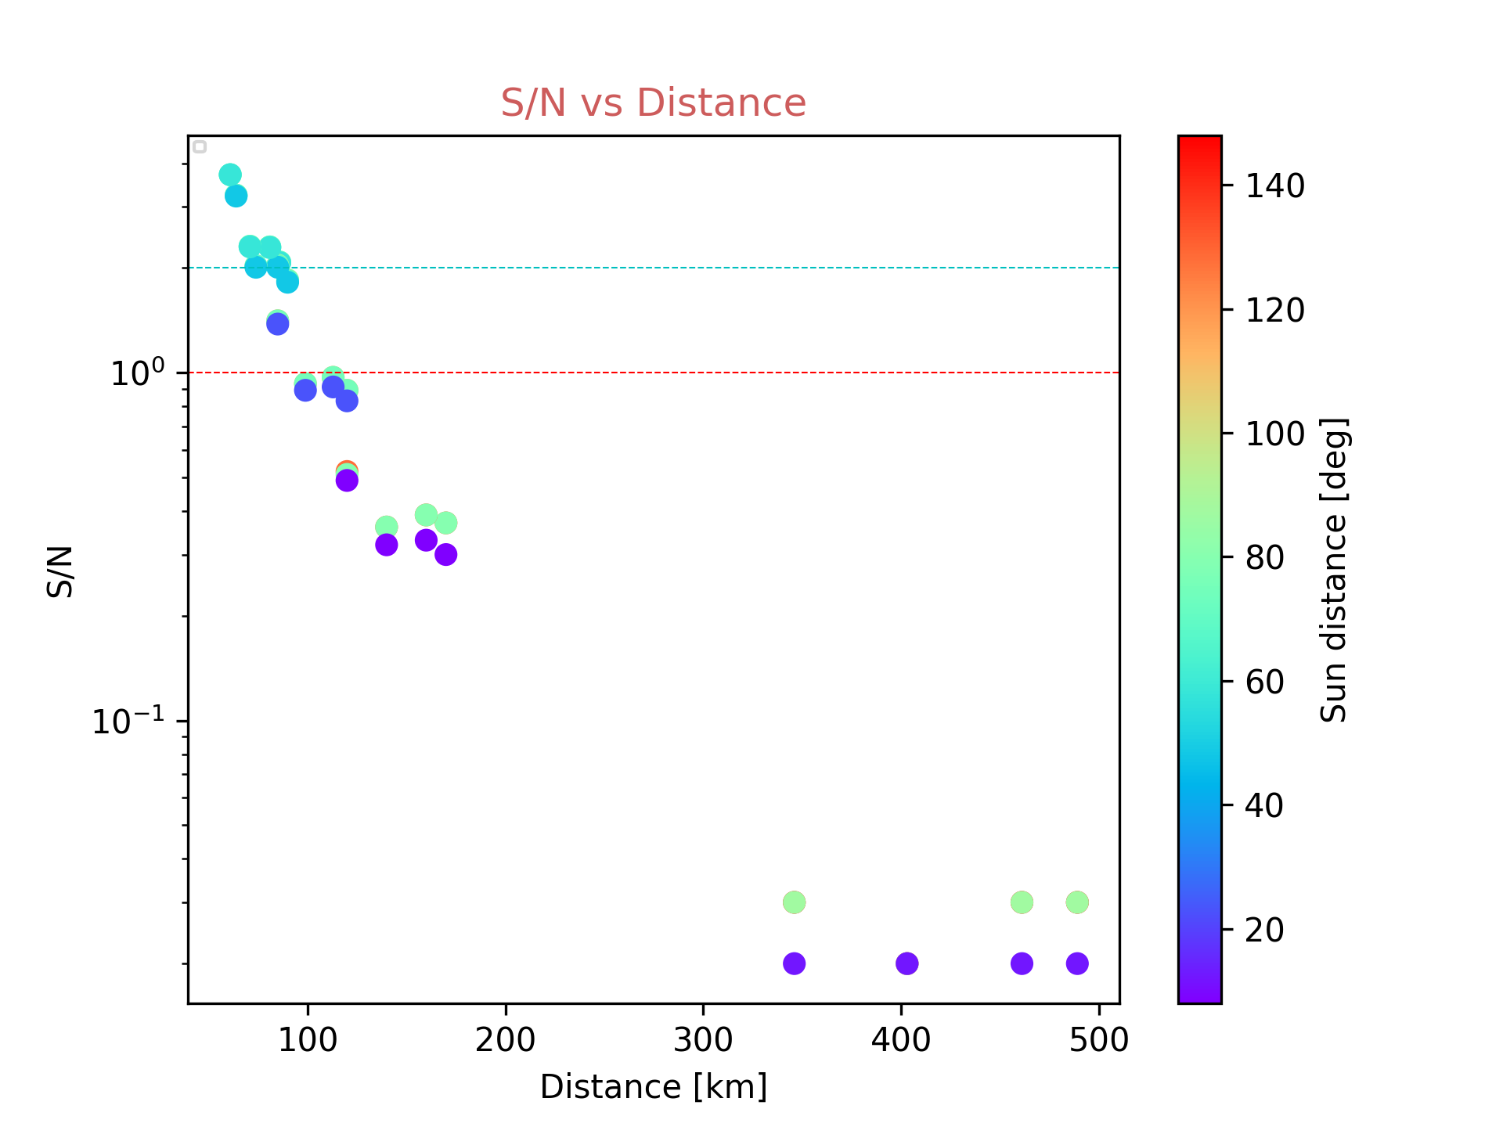
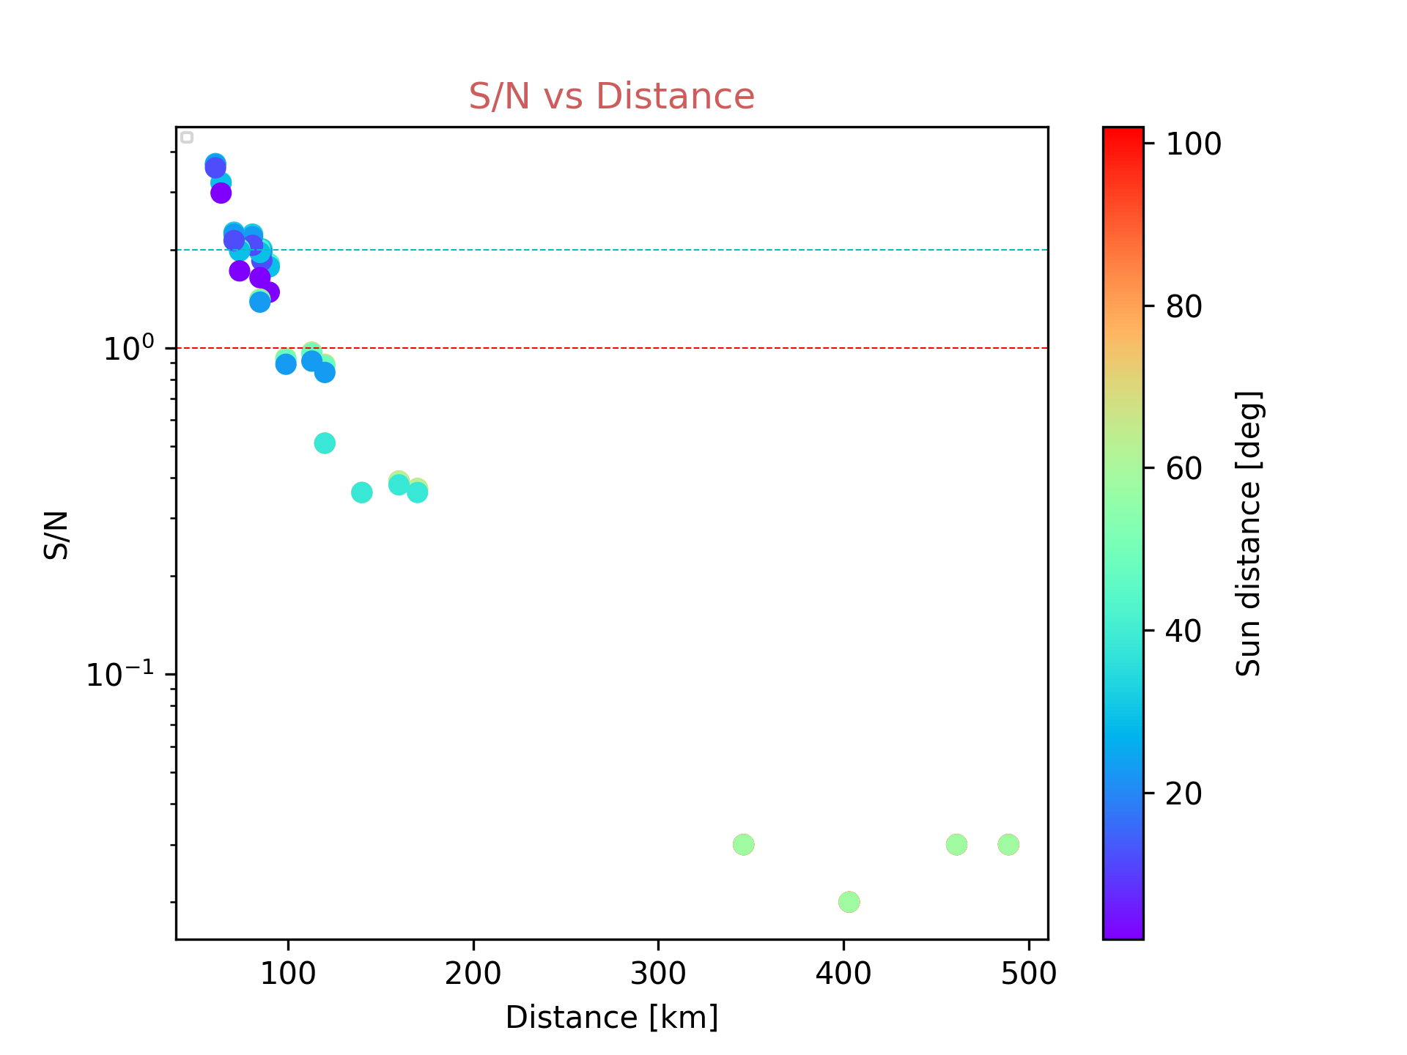
The culprit…
Winter
Summer

Slide 10
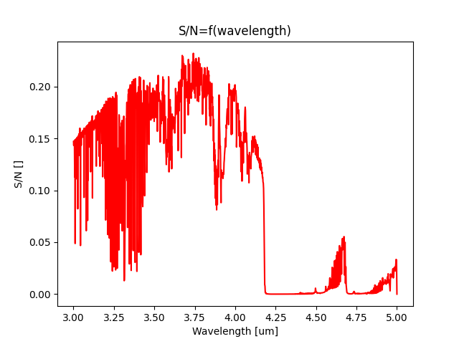
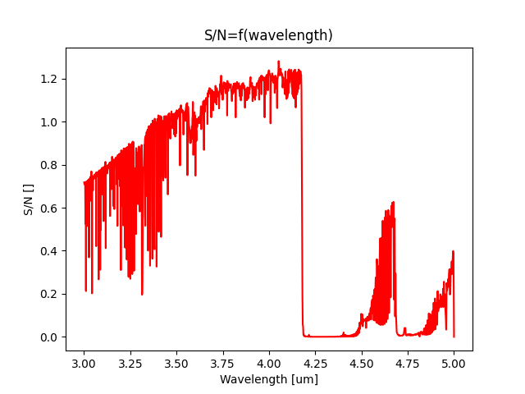
Q4: can we narrow down the spectral band?
Spectrally resolved S/N
Winter
Alt=20 km, Az=90 deg, El=45 deg
Winter
Alt=40 km, Az=180 deg, El=70 deg

Slide 11
Conclusion
M-IR detection of meteors is feasible under restricted conditions
The driving factor is the physical distance between the meteoroid and the camera, because of Black body radiation of meteoroid in M-IR band
Assumption of point-like source might not hold in case of meteoroid disruption

